Slide 1
Graph-Based Approach for Pulmonary Diseases Classification
By Anuranj VV
Under the Supervision of
Dr. R. Sunitha
Associate Professor
Pondicherry University

Slide 2
Introduction
The internship focused on advanced medical image processing techniques using Graph Attention Networks (GAT).
X-ray images were transformed into super pixel representations to improve feature extraction efficiency.
GAT was employed to extract meaningful features, leveraging attention mechanisms for better interpretability.
The approach was evaluated for its effectiveness in enhancing classification performance in medical imaging.
Notes:
Graph Attention Networks (GAT) are a type of Graph Neural Network (GNN) that leverages the attention mechanism to process graph-structured data. Unlike traditional GNNs (e.g., GCN), which aggregate information from neighbors with fixed weights, GAT assigns learnable attention scores to the neighbors, enabling the model to focus on the most relevant nodes for each task.
Superpixel segmentation is a preprocessing technique in computer vision that groups pixels in an image into perceptually meaningful regions called super pixels. These regions are collections of adjacent pixels with similar color, intensity, or texture properties, which are often used as building blocks for higher-level image analysis tasks.

Slide 3
Materials and Methods
X-ray image datasets: MIMIC-CXR database with over 377,000 chest X-ray images.
Preprocessing X-ray images by resizing to a fixed size (256x256) and normalizing pixel values and augmentation.
Segmenting images into super pixels using the SLIC algorithm to capture meaningful patterns.
Building Region Adjacency Graphs (RAGs) to model the relationships between super pixels
Applying Graph Attention Networks (GAT) to extract significant features from the graph-structured data.
Notes:
What Happens: The GAT operates on this graph structure and uses attention mechanisms to extract features. Specifically:Graph Nodes: Each superpixel has a feature representing its intensity (mean intensity) in the image.
Graph Edges: The edges represent the relationship between adjacent superpixels.
The GAT layer computes a weighted sum of the features of neighboring nodes (superpixels), with the weights determined dynamically by the attention mechanism. This helps the model focus on the most relevant neighboring superpixels based on their importance for the task.

Slide 4
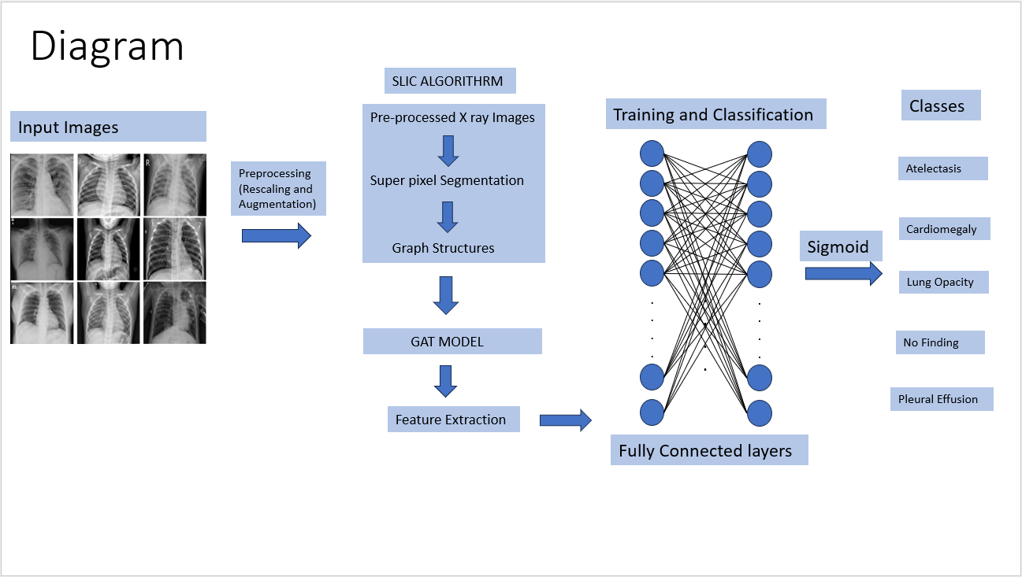

Slide 5
Graph Attention Networks (GAT)
Leveraged attention mechanisms to focus on the most important super pixels (nodes) in the graph.
Allowed selective processing by assigning varying importance to graph nodes based on their features and connections.
Enhanced the model's ability to capture local and global relationships within the graph representation.
Provided flexibility in handling varying graph structures, improving feature extraction for pulmonary disease classification.
Integrated the GAT output into fully connected layers to classify X-ray images into distinct pulmonary conditions.
Notes:
Graph-structured data: Input consists of nodes VVV, edges EEE, and node features XXX.Attention mechanism: Computes weights for each edge, emphasizing important neighbors.Message passing: Aggregates information from neighbors using the computed attention weights.Multi-head attention: Combines attention scores from multiple heads for robustness.Output layer: Generates task-specific outputs, such as node embeddings or classifications.
Graph Attention Networks (GAT) are a type of Graph Neural Network (GNN) that leverages the attention mechanism to process graph-structured data. Unlike traditional GNNs (e.g., GCN), which aggregate information from neighbors with fixed weights, GAT assigns learnable attention scores to the neighbors, enabling the model to focus on the most relevant nodes for each task.
Key Components of GAT:
Graph-structured data: Input consists of nodes VVV, edges EEE, and node features XXX.
Attention mechanism: Computes weights for each edge, emphasizing important neighbors.
Message passing: Aggregates information from neighbors using the computed attention weights.
Multi-head attention: Combines attention scores from multiple heads for robustness.
Output layer: Generates task-specific outputs, such as node embeddings or classifications.
Workflow of GAT:
Input:
A graph represented as G=(V,E)G = (V, E)G=(V,E), where VVV is the set of nodes and EEE is the set of edges.
Each node viv_ivi​ has a feature vector hi∈Rd\mathbf{h}_i \in \mathbb{R}^dhi​∈Rd.
Self-attention on Graph:
Compute pairwise attention scores between a node and its neighbors.
Attention score between node iii and neighbor jjj: eij=LeakyReLU(a⊤[Whi∣∣Whj]),e_{ij} = \text{LeakyReLU}(\mathbf{a}^\top [\mathbf{W} \mathbf{h}_i || \mathbf{W} \mathbf{h}_j]),eij​=LeakyReLU(a⊤[Whi​∣∣Whj​]), where W\mathbf{W}W is a weight matrix, a\mathbf{a}a is the attention vector, and ∣∣||∣∣ denotes concatenation.
Softmax Normalization:
Normalize the attention scores across all neighbors of node iii: αij=exp⁡(eij)∑k∈N(i)exp⁡(eik).\alpha_{ij} = \frac{\exp(e_{ij})}{\sum_{k \in \mathcal{N}(i)} \exp(e_{ik})}.αij​=∑k∈N(i)​exp(eik​)exp(eij​)​.
αij\alpha_{ij}αij​ represents the importance of neighbor jjj to node iii.
Message Passing and Aggregation:
Aggregate the information from neighbors: hi′=σ(∑j∈N(i)αijWhj),\mathbf{h}_i' = \sigma \left( \sum_{j \in \mathcal{N}(i)} \alpha_{ij} \mathbf{W} \mathbf{h}_j \right),hi′​=σ​j∈N(i)∑​αij​Whj​​, where σ\sigmaσ is an activation function (e.g., ReLU).
Multi-head Attention:
Repeat the above steps for multiple attention heads and concatenate or average the results: hi′′=∥k=1Khi(k)(concatenation for each head k).\mathbf{h}_i'' = \|_{k=1}^K \mathbf{h}_i^{(k)} \quad \text{(concatenation for each head \( k \))}.hi′′​=∥k=1K​hi(k)​(concatenation for each head k).
Output:
Depending on the task:
Node-level task: Output embeddings or class probabilities for each node.
Graph-level task: Pool node embeddings to generate a graph-level representation.

Slide 6
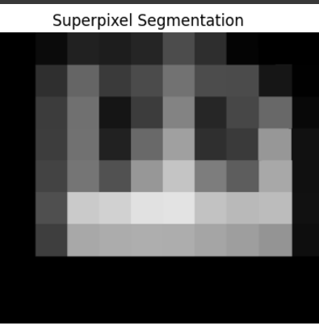
SLIC ALGORITHEM
SLIC algorithm is a widely used technique for generating super pixels in image segmentation, which groups pixels into perceptually meaningful clusters.
Efficiently segments images into compact super pixels, balancing quality and computational efficiency while preserving image boundaries.
SLIC preserves key features in X-ray images, making it ideal for highlighting critical areas in medical diagnosis.
Converting X-rays into super pixels enhances feature extraction, reducing noise and improving detection of fine details.
Notes:
SLIC) algorithm is a widely used technique for generating superpixels in image segmentation, which groups pixels into perceptually meaningful clusters.
Efficiently divides images into compact, uniform superpixels that preserve image boundaries, offering a balance between segmentation quality and computational efficiency.
SLIC maintains the structural integrity of important features in X-ray images, making it ideal for highlighting areas that require attention in medical diagnosis.
Converting X-ray images into superpixels enables more focused feature extraction, reducing noise and enhancing the model's ability to detect fine details in lung tissue or abnormalities.
Superpixel Segmentation
Superpixel segmentation is a preprocessing technique in computer vision that groups pixels in an image into perceptually meaningful regions called superpixels. These regions are collections of adjacent pixels with similar color, intensity, or texture properties, which are often used as building blocks for higher-level image analysis tasks.
SLIC (Simple Linear Iterative Clustering):
Most widely used superpixel algorithm.
Clusters pixels based on their spatial and color proximity in the CIELAB color space.
Ensures compact and uniform superpixels.
Computationally efficient and widely adopted for various tasks.

Slide 7
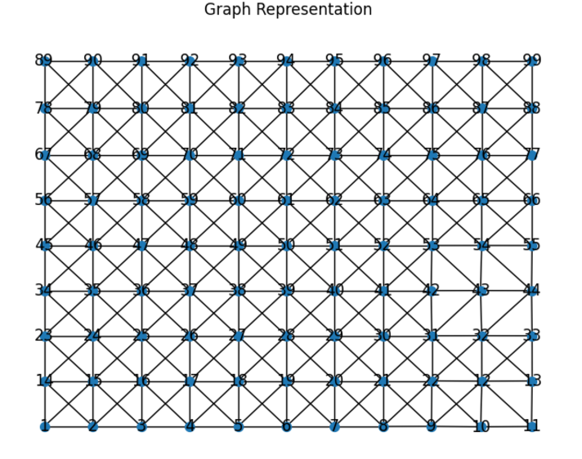
RAG (Region Adjacency Graph)
RAG represents super pixels as nodes, with edges connecting adjacent super pixels, capturing spatial relationships.
Converts pixel-level data into graph-level data, simplifying complex image structures.
Allows combining superpixel-level features, improving interpretability and model performance.
RAG effectively preserves structural integrity and spatial relationships in X-ray super pixels, aiding in better diagnosis.
Notes:
Converting a Region Adjacency Graph (RAG) into a NetworkX graph is a key step in leveraging graph-based machine learning models, such as Graph Attention Networks (GAT). Here's why this step is important:
A Region Adjacency Graph (RAG) is a graph-based representation of an image where:
Nodes represent regions or segments of the image (e.g., superpixels or clusters of pixels).
Edges represent the adjacency or relationship between these regions.
Input:
Start with an image or a pre-segmented version of the image (e.g., using superpixel segmentation).
Segmentation:
Divide the image into regions using segmentation techniques like:
SLIC (Simple Linear Iterative Clustering).
Watershed segmentation.
Graph-based segmentation.
Graph Construction:
Create a graph G=(V,E)G = (V, E)G=(V,E), where:
VVV: Nodes represent regions.
EEE: Edges connect adjacent regions.
Optionally, compute weights for edges based on region properties.
Feature Extraction:
Extract features for each node (e.g., average color, texture).
Extract edge features (e.g., similarity measures).
Analysis:
Use the RAG for tasks like:
Merging similar regions.
Object segmentation.
Feature-based classification.
Output:
A graph representation of the image for further processing.

Slide 8
RESULTS
The model achieved a precision of approximately 0.5 for some classes, which is promising for a challenging multi-class classification task in the medical imaging domain.
The Lung Opacity and Pleural Effusion classes show moderate performance with precision scores of 0.35 and 0.45, respectively, demonstrating the potential for distinguishing these conditions.
Classes like Atelectasis and Cardiomegaly had lower precision and recall, highlighting the need for further training or rebalancing of the dataset.
The model achieved a micro-average precision of 0.46, indicating its overall ability to correctly classify samples across all classes.
Notes:
Model Performance Insights:
The model achieved a precision of approximately 0.5 for some classes (e.g., "No Finding" and "Pleural Effusion"), which is promising for a challenging multi-class classification task in the medical imaging domain.
Class-Specific Observations:
The "No Finding" class achieved the best performance with a precision of 0.47, suggesting the model is reasonably effective at identifying cases without abnormalities.
The "Lung Opacity" and "Pleural Effusion" classes show moderate performance with precision scores of 0.35 and 0.45, respectively, demonstrating the potential for distinguishing these conditions.
Room for Improvement in Rare Classes:
Classes like "Atelectasis" and "Cardiomegaly" had lower precision and recall, highlighting the need for further training or rebalancing of the dataset to improve recognition of rare conditions.
Balanced Performance:
The model achieved a micro-average precision of 0.46, indicating its overall ability to correctly classify samples across all classes.
Confusion Matrix Analysis:
The confusion matrix reveals key misclassifications between similar classes (e.g., overlap between "Lung Opacity" and "No Finding"), pointing to opportunities for fine-tuning and feature enhancement.

Slide 9
Conclusion
Introduced a graph-based framework using Graph Attention Networks (GAT) for pulmonary disease classification, surpassing traditional models.
Converted chest X-rays into graph structures to capture complex local and global data relationships.
Used super pixel segmentation and advanced feature extraction for improved diagnostic accuracy.
Achieved promising results on the MIMIC-CXR dataset, showcasing the potential of graph-based deep learning in medical imaging.

Slide 10
Future Works
Expand the model to other medical imaging modalities (e.g., MRI, CT scans).
Use sampling techniques to balance datasets and improve diagnostic accuracy for underrepresented conditions.
Integrate ensemble models to boost predictive performance by leveraging multiple classifiers.
Increase the diagnostic scope by training the model on a broader range of diseases, enhancing its applicability in real-world scenarios.

Slide 11
Acknowledgement
I, Anuranj VV declare that the Project report titled “Graph-Based Approach for Pulmonary Diseases Classification” submitted herein has completed my internship at Pondicherry University during the period of the internship from 18-June-2024 to 30-July-2024. I affirm that this report is an original work carried out by me under the guidance and supervision of Dr. R. Sunitha, Associate Professor from the Department of Computer Science, Pondicherry University.

